Slide 1
Energy Standards/Codes
&
Impact on Fan Selection
April 2017
Mike Wolf, P.E. mike.wolf@greenheck.com

Slide 2
Learning Objectives
Energy Legislation & Terminology
Fan Energy Regulation Metrics
Energy Code Fan System Requirements
Elements of Fan System Energy – Personal Perspectives

Slide 3
Energy Legislation and Initiatives
History & Trivia

Slide 4



What initiated energy legislation in the
United States today?
  Organization of Petroleum Exporting Countries(OPEC) Oil Embargo (1973)
  38th President Gerald Ford (Republican) signed Energy Policy & Conservation Act of 1975 (EPCA)
  US DOE established August 1977
Notes:
3 Initiatives of EPCA
Strategic Petroleum Reserves – Underground in TX and LA
727 Million Barrel Capacity @ 20 Million per day = 36 days (about 1 month).
Withdrawal capacity is only 4.4M barrels per day = 160 days (about 6 months) to use up the entire inventory.
Programs to encourage production of domestic energy sources:
Coal
Oil
Natural Gas
Prohibited crude oil exports until 2015
Energy Efficiency Initiatives
Fuel Economy Standards for Automobiles
Energy Conservation Standards for Consumer Products
Appliances and Equipment.
DOE currently regulates over 50 products
DOE – Established in 1977
Modifications/Amendments/Updates
1975 (Ford – Republican) - EPCA
1977 (Carter – Democrat) – Established DOE
1978 (Carter – Democrat) – National Energy Act
1980 – (Carter – Democrat) - Energy Security Act
1992 (GHW Bush – Republican) – Energy Policy Act
2005 (GW Bush – Republican) – Energy Policy Act
2007 (GW Bush – Republican) – Energy Independence & Security Act
2009 (Obama – Democrat) – American Recovery & Reinvestment Act
2015 (Obama – Democrat) – Clean Power Plan
1977 - Three Days of the Condor

Slide 5

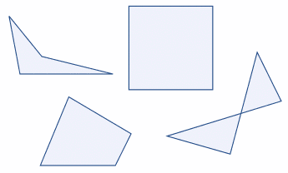

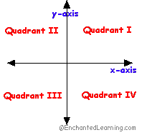
What is a Quad?
Notes:
Note – Republican President in 2008 & 09.

Slide 6
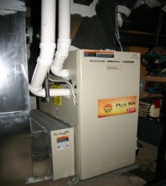

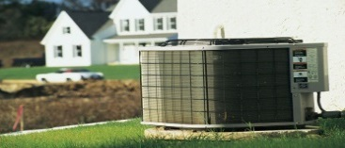
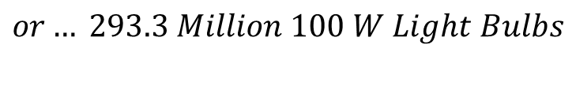
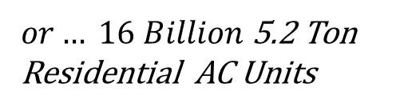
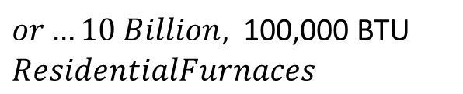
A Quad is*…
1,000,000,000,000,000 BTU
293,297,222,222 kWh
83,333,333,333 Tons of AC
$or…10 Billion,$100,000 BTU $ResidentialFurnaces$
$$or… 293.3 Million 100 W Light Bulbs$$
$or… 16 Billion$ 5.2 Ton
Residential AC Units
  *Presenter is not responsible for conversions.
Notes:
Insert Pictures
Typical Furnace @ 100,
1 Quad
=1 Quadrillion BTU = 10 Billion Residential Furnaces
= 83 Billion Tons of AC = 1.6 Billion Residential Air Conditioners
= 293 Billion KW-h = 1 100W bulb for 334.5 Thousand Years or 334.5 Thousand 100W Light bulbs for 1 year.
= 39.3 Billion Hp-h = 1 10HP motor for 3.9 Billion Years or 3.9 Billion 10HP motors for 1 year
= $29.3B @ $0.10/KWh
45 Million Tons of Coal = 450,000 Rail Cars of Coal = Pile 10 ft. thick x 1 mile wide x 3.3 miles long (9 miles to drive around @ 60mph)1
170 million barrels of crude oil
293 Billion KW Hours = 100 Bulb for 3.3 Trillion Years
39.3 Billion Hp Hours = 40 for 4 million years

Slide 7

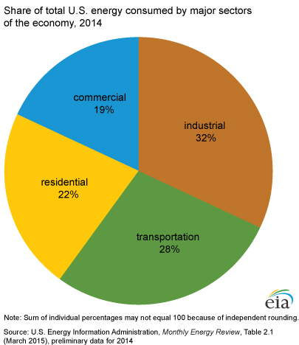
United States
Annual Energy Consumption = 100 Quads
Notes:
U.S. Uses about 100 Quadrillion BTUs of Energy per Year.
Most Energy comes from Petroleum, Natural Gas & Coal.
More than half of the energy produced in the U.S. is wasted (about 57%) or 43% Efficient
Waste Heat from Power Plants, Cars, Lights…
Electrical Power Generation – 33% Efficient
4 Main Consumers of Energy are Residential, Commercial, Industrial, and Transportation
Transportation – 25% Efficient
Industrial, Commercial & Residential – 80% Efficient

Slide 8
Background
According to the DOE U.S. fans consume:
  0.9 quads of electricity in industrial applications
  1.6 quads of electricity in commercial applications
  (2.5 quads is about 2.5% of total)
  * Sources: DOE and LLNL

Slide 9
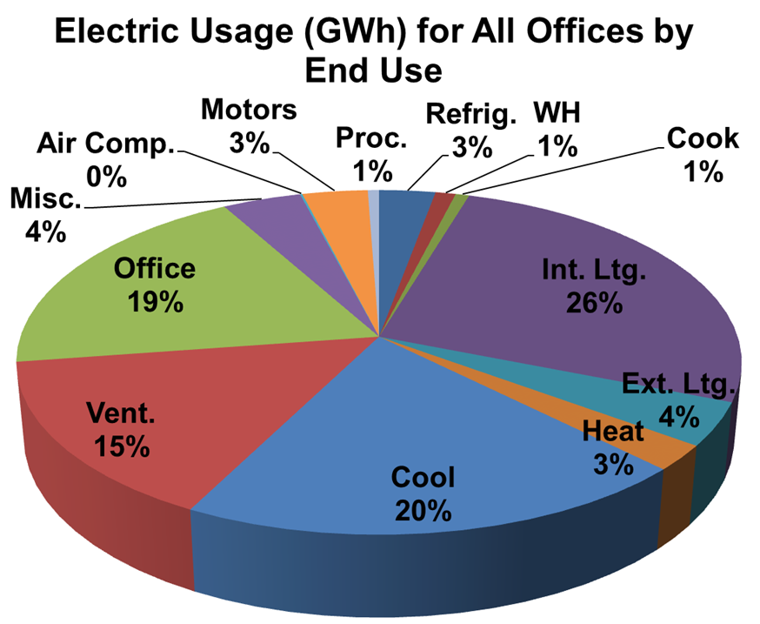
Commercial Building Energy
Fans=15%
(30%-40%) of HVAC
HVAC=40%
California Commercial End-use Survey, prepared for CEC by Intron, Inc., March 2006; CEC-400-2006-005

Slide 10
Fan Energy Consumption
Power Input
(Electrical)
Power Loss !
Power Output
(Flow and Pressure)

Slide 11
What is Fan Efficiency?
Power Output
Efficiency =
Power Input
CFM x Pressure
Fan Efficiency =
BHP
Notes:
Fan efficiency is defined as any other efficiency, power output divided by power input.
For a fan, the output is CFM and Pressure, the input is BHP.

Slide 12
What is Fan Efficiency?
CFM x Ps
Static Efficiency = x 100%
6343.3 x BHP
CFM x PT
Total Efficiency = x 100%
6343.3 x BHP
P_{T} = P_{S} + P_{V}
Notes:
The actual equations are shown here. They are similar in form. Use static efficiency for applications with static pressure and use total efficiency for applications with total pressure.

Slide 13
Fan Curves
6.0
Ps vs. CFM
5.0
10.0
BHP vs. CFM
4.0
Surge Area
8.0
BHP
Ps
3.0
6.0
2.0
4.0
1.0
2.0
0.0
0.0
0
2
4
6
8
10
12
CFM x 1000
Notes:
The most basic fan curve shows pressure plotted against airflow. During the test, a series of points are measured and a curve is drawn between them. This is a constant speed fan curve. At this speed, the fan will always operate somewhere along this curve.
Most fans have some form of a surge or stall area. As the pressure rises approaching this point on the curve, the air begins to separate off the lower pressure side of the blades. This is accompanied by an increase in low frequency, or rumbly sound. Fans should not be selected or operated in the surge area.
We also normally plot fan shaft power against airflow. The power curve can look like this one, with a peak power somewhere in the middle of the curve. Or, in the case of a radial bladed or forward curve centrifugal, it would continue rising and have a peak power at the maximum airflow.

Slide 14
Fan Curves
P_{T} = P_{S} + P_{V}
6.0
P_{T}
5.0
100
P_{S}
Total Efficiency
4.0
80
Pressure
3.0
60
Efficiency
2.0
40
1.0
20
Static Efficiency
0.0
0
0
2
4
6
8
10
12
CFM x 1000
Notes:
While it is more common to see static pressure on a fan curve, we can also show total pressure. The difference between the fan total pressure and the fan static pressure is the velocity pressure at the discharge of the fan.
Likewise, we can also show the total efficiency curve. The total efficiency curve will always have a higher peak than the static efficiency curve, and the peak total efficiency will always occur somewhat to the right of the peak static efficiency (at a higher CFM).

Slide 15
Fan Selection for Efficiency
6.0
5.0
Ps
High Efficiency, Low Sound
10.0
4.0
Surge Area
8.0
BHP
BHP
Ps
3.0
6.0
2.0
Static Efficiency
4.0
1.0
Low Efficiency, High Sound
2.0
0.0
0.0
0
2
4
6
8
10
12
CFM x 1000
Notes:
We can actually break the fan curve into 3 major regions.
The surge area is on the left side of the fan curve. It can either be horizontal or can have a dip in pressure and keep rising to the left.
The bottom half of the fan curve is the least efficient and loudest part of the fan curve.
As you move up the fan curve, the efficiency increases and the sound decreases.

Slide 16
Fan Performance vs. Fan Application
High Efficiency, Low Sound
% Ps
Static Efficiency
Peak SE
Actual
Selections
% CFM
Notes:
We talked about where the fans are most efficient and where the fans should be used for optimum efficiency. But where are people actually selecting and using these fans?
In order to answer this question, I gathered some historic data for fans that we sold over the past year. I looked at both plenum fans and inline mixed flow fans, some very popular fan models. I took the actual selections and normalized them based on their position on the fan curve so that I could plot them in relationship to the peak static efficiency.
If you look at this as a histogram on top of a fan curve, the result was a bell curve that started very close to the peak SE point and moved out to the right, toward free air. So the bulk of the fan selections were well to the right of the peak efficiency fan selection. What this shows is that customers are not purchasing the fan size that resulted in peak efficiency. The actual selections were made using smaller fans running at higher speeds.
Causes – could be improved stability, but I think it’s more likely that the person buying the fan is not paying the electric bills. The contractor is more concerned with first cost than operating cost.
Efficiency is a very hot topic at AMCA and it’s the most important topic with ASHRAE, not to mention internationally.
If we want to seriously impact energy efficiency, we need to shift this histogram to the left. We need to make more selections on the higher efficiency part of the fan curve. That will cost a little more money to purchase a slightly larger fan, but if we consider the cost of the motor and drive and consider the cost of electricity, the payback will be very short.

Slide 17
Fan Energy Regulation Metrics

Slide 18


Fan Energy Regulation Metrics
Standards/Codes (being adopted)
  Fan Efficiency Grade (FEG)
Dept. of Energy (in development)
  Fan Energy Index (FEI)

Slide 19
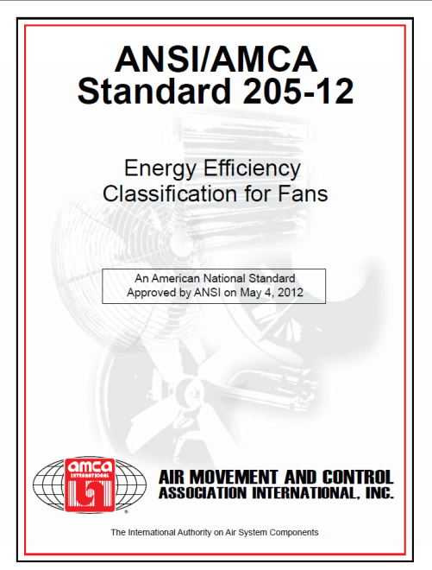
Fan Efficiency Grades
ANSI/AMCA Standard 205-10 – Energy Efficiency Classifications for Fans
ISO 12759:2010 Fans – Efficiency Classification for Fans
Notes:
I talked a lot about efficiency and what it means to fan. The next part to look at is how Fan Efficiency Grades are derived from the fan size and total efficiency. AMCA standard 205-10 defines Fan Efficiency Grades

Slide 20
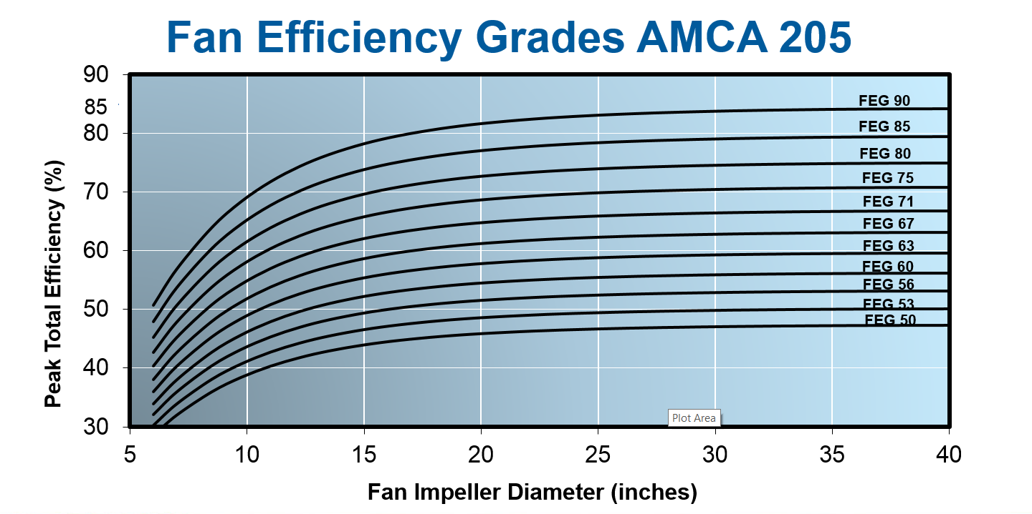

Slide 21
Fan Efficiency Grades AMCA 205
Airfoil Centrifugal
Backward Inclined
Forward Curved
Notes:
Scrolled housings

Slide 22
AMCA 205
AMCA 205, Annex A:
In order to achieve the goals in energy savings by
operating fans it is important that the fan is selected
in the system close to the peak of the fan efficiency.
The fan operating efficiency at all intended operating
point(s) shall not be less than 15 percentage points
below the fan peak total efficiency (see figure).
Notes:
AMCA 205 also includes a statement that requires selection of the fan within 15 percentage points of the peak. This was originally published at 10%, but was changed due to resistance from some of the ASHRAE stakeholders.

Slide 23
Fan Efficiency Grades
6.0
Ps vs. CFM
5.0
100
Peak 75%
4.0
80
Ps
3.0
Total Efficiency vs. CFM
60
Efficiency
2.0
40
1.0
20
0.0
0
0
2
4
6
8
10
12
CFM x 1000
Notes:
Remember back to our example of a fan with 75% peak efficiency.

Slide 24
Fan Curves
6.0
60% Minimum within 15 points of peak efficiency
Ps vs. CFM
5.0
100
4.0
80
Ps
3.0
Total Efficiency vs. CFM
60
Efficiency
2.0
40
1.0
20
0.0
0
0
2
4
6
8
10
12
CFM x 1000
Notes:
Selection within 15 points of peak efficiency allows a range down to 60%

Slide 25
“Things are not always as they seem; the first appearance deceives many.”
- Phaedrus (Plato)

Slide 26
Fan Types
40,000 CFM at 0.25” Ps
Model
Impeller Dia
BHP
FEG
$
Cost
Sidewall Prop
54”
7.11
56
1.0
Tube Axial
54”
8.30
67
1.7
Vane Axial
54”
6.87
75
4.4
Housed Centrifugal
49”
13.4
90
3.8
Housed Centrifugal
60”
6.8
90
6.1
Notes:
This is an extreme example, but a real example of a high volume, low pressure fan selection.
For 40,000 CFM at 0.25” of pressure in a non-ducted application, the prop fan is the right fan for the job.
The 54” prop I am showing here has a relatively low FEG value. But a similar prop in a tubular housing with a higher FEG value actually consumes more power. And the vane axial, designed for much higher pressures, isn’t much better. You can see the ratio of first costs on the right hand side. You would never see the vane axial pay for itself in energy savings for this example.
I included the airfoil centrifugal fans, just because their FEG value is so high. The similar sized impeller uses almost twice the power. And in order to get the power down you would need such a large blower wheel, it would require a 20 hp motor just to start it.
Now you can get a sidewall prop fan with a higher FEG value. I can pick another prop that is FEG71, but the power consumed isn’t necessarily any lower. There are 2 reasons for this. First, the FEG value is based on the peak efficiency, not the actual operating efficiency. Second, a sidewall fan prop fan is non-ducted, so it always used to increase the static pressure. The total efficiency in this case isn’t a very good indicator of the actual power consumed.

Slide 27
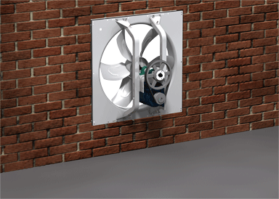
Fan Types
Adhering to codes that require minimum fan efficiency grades will result in replacing this:

Slide 28
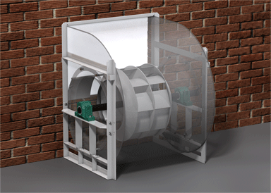
Fan Types
With this:

Slide 29
Limitations of Fan Efficiency Grade (FEG)
FEG is an indicator of peak total efficiency
FEG NOT an indicator of fan input power
FEG is NOT a good comparison of fan power
FEG is LIMITED by fan type and horsepower

Slide 30
So what metric will the DOE use to regulate fan efficiency?

Slide 31

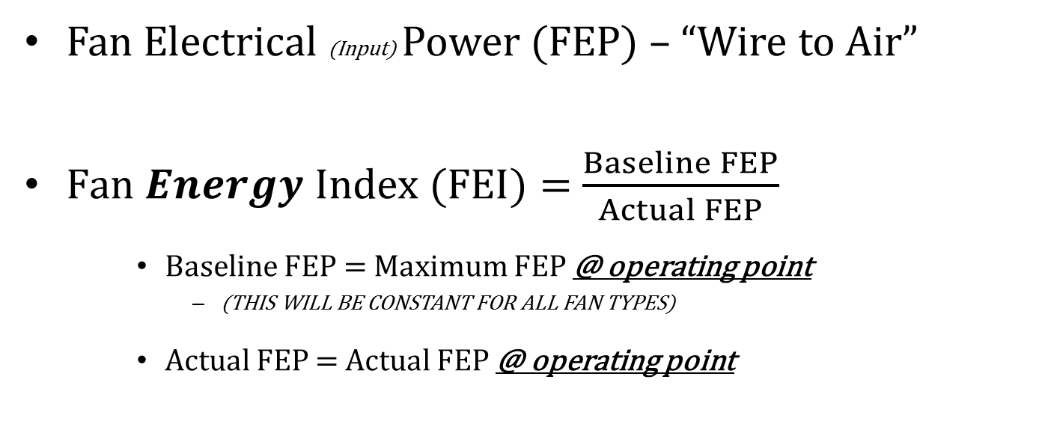
DOE Fan Energy Regulation
Fan Electrical (Input) Power (FEP) – “Wire to Air”
$Fan Energy Index (FEI)=$ $\frac{Baseline FEP}{Actual FEP}$
    Baseline FEP = Maximum FEP @ operating point
      (THIS WILL BE CONSTANT FOR ALL FAN TYPES)
    Actual FEP = Actual FEP @ operating point

Slide 32
Fan Energy Consumption
Fan Power
(at the shaft)
Overall Fan Power (wire to air)
Electrical Power In
Motor Loss (10%)
Drive Loss (3% -10%)
Bearing Loss (3%)
Aerodynamic Loss (10% to 20%)
Fan Power Out

Slide 33
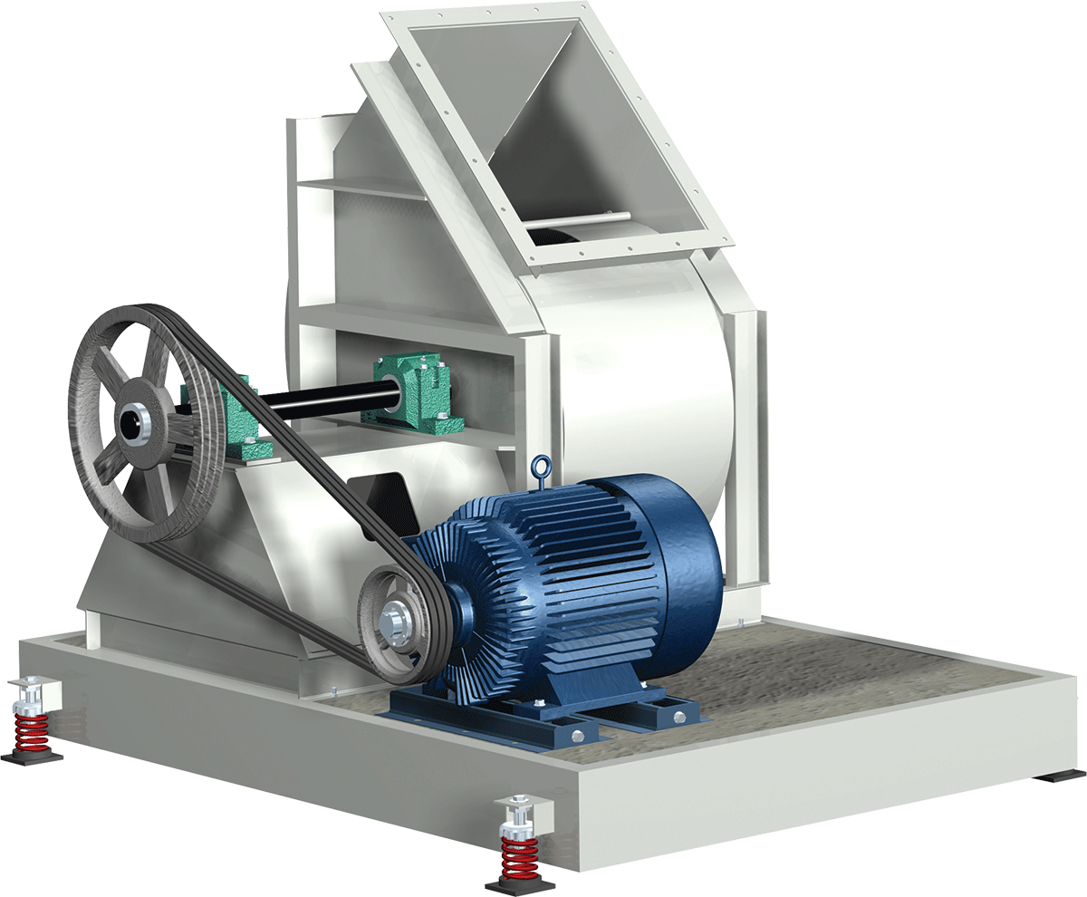
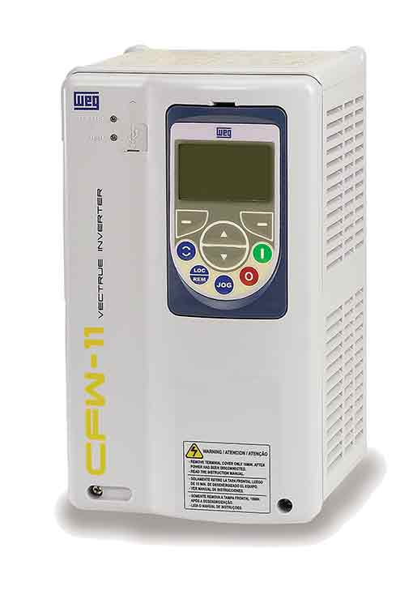
Overall Fan Energy
VFD Electrical Loss
Power Output
Bearing Friction Loss
Aerodynamic Loss
Motor Electrical Loss
Additional Motor Loss
Input Power
V-Belt Friction Loss
Notes:
Build slide.
What do I mean by “Overall Energy Efficiency”?
It is how efficiently we convert electrical energy into useful energy of the airstream.
In the process of developing this useful energy in the airstream there are various sources of losses:
The impeller and fan have internal aerodynamic losses and those losses actually go into heating of the airstream.
The bearings have internal frictional losses, both from the rolling elements and the seals that keep the bearings clean and lubricated. These losses cause the bearing housings to heat up.
The V-belt drive also has some frictional losses.
The motor has internal electrical losses which again result in excess heat.
The motor is controlled by an inverter drive or VFD which has its own electrical loss and also causes additional losses inside the motor.
All these losses reduce the efficiency of the overall fan system.

Slide 34
Fan Efficiency Index (FEI)
FEI varies along the fan curve
Pressure
2.0
Pressure
Fan Efficiency Ratio - FEI
1.0
FEI
0
Airflow

Slide 35
Fan Selections
Narrow selection range around peak efficiency at high CFM and Ps
Allowable
Selection Range
Wide selection range at low CFM and Ps
Notes:
Here is the best way to look at how this proposed scheme would affect fan selections. Everyone is familiar with this type of plot – multiple speed fan curves used for making fan selections. The surge line is shown here as well as the peak efficiency line. The peak efficiency is shown as a parabola passing through similar points on each curve. This plot is shown in static pressure, but a similar curve could be shown in total pressure with a total efficiency requirement.
If the minimum required efficiency varies with the log of both CFM and pressure, it follows that this efficiency requirement would be lowest at the lowest fan speed. A large portion of the fan curve satisfies this requirement and so the fan can be selected almost anywhere on the fan curve.
When you get to the highest speed curve, the efficiency requirements are higher, so the allowable selection range is a smaller part of the fan curve near the peak efficiency point.
Likewise, in the middle speed range, the allowable selections fall within a certain range on the fan curve.
If you connect the points on each curve that satisfy the efficiency requirements, you get a “bubble” of allowable selections. The selection range that the bubble covers is wide at the bottom, covering most of the low speed curve, but then gets narrower as the speed of the fan increases. Any selection inside the bubble is allowable. In this example, for an application requiring 5” Ps, this fan meets the requirement at 30,000 CFM, but it does not meet the requirement at 40,000 CFM. At 40,000 CFM you would need to select the next larger fan size. But remember, the efficiency requirement is based only on the CFM and Ps, so every other fan considered for use at 40,000 CFM and 5” Ps would have the exact same efficiency (or power) requirement.
The red line is found by solving this efficiency equation for each point on the fan curve. This bubble could be shown on a each catalog page, or in any electronic catalog.

Slide 36
Fan Performance vs. Fan Application
High Efficiency, Low Sound
% Ps
Static Efficiency
Peak SE
Actual
Selections
% CFM
Notes:
We talked about where the fans are most efficient and where the fans should be used for optimum efficiency. But where are people actually selecting and using these fans?
In order to answer this question, I gathered some historic data for fans that we sold over the past year. I looked at both plenum fans and inline mixed flow fans, some very popular fan models. I took the actual selections and normalized them based on their position on the fan curve so that I could plot them in relationship to the peak static efficiency.
If you look at this as a histogram on top of a fan curve, the result was a bell curve that started very close to the peak SE point and moved out to the right, toward free air. So the bulk of the fan selections were well to the right of the peak efficiency fan selection. What this shows is that customers are not purchasing the fan size that resulted in peak efficiency. The actual selections were made using smaller fans running at higher speeds.
Causes – could be improved stability, but I think it’s more likely that the person buying the fan is not paying the electric bills. The contractor is more concerned with first cost than operating cost.
Efficiency is a very hot topic at AMCA and it’s the most important topic with ASHRAE, not to mention internationally.
If we want to seriously impact energy efficiency, we need to shift this histogram to the left. We need to make more selections on the higher efficiency part of the fan curve. That will cost a little more money to purchase a slightly larger fan, but if we consider the cost of the motor and drive and consider the cost of electricity, the payback will be very short.

Slide 37
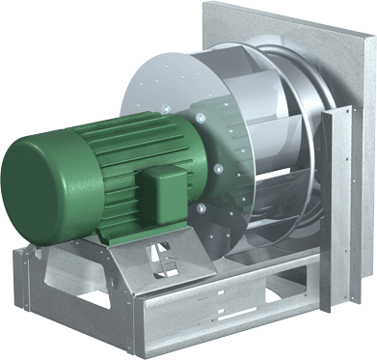
What does this mean to Fan Selections?
Multiple Speed Fan Performance Curves
“Relatively High Efficiency Fan” – Large selection area
Static Pressure
Peak Efficiency
FEI 1.1
FEI 1.2
FEI 1.0
FEI 0.9
Airflow

Slide 38
What does this mean to Fan Selections?
Electronic Fan Selection Software based on Total Pressure
Design Point 10,000 CFM at 3.0” Pt
Fan Size (in.) | Fan Speed (rpm) | Fan Power (bhp) | Actual Total Efficiency | Baseline Power (bhp) | Baseline Total Efficiency | FEI
18 | 3238 | 11.8 | 40.1% | 7.96 | 59.4% | 0.67
20 | 2561 | 9.56 | 49.5% | 7.96 | 59.4% | 0.83
22 | 1983 | 8.02 | 59.0% | 7.96 | 59.4% | 0.99
24 | 1579 | 6.84 | 69.1% | 7.96 | 59.4% | 1.16
27 | 1289 | 6.24 | 75.8% | 7.96 | 59.4% | 1.28
30 | 1033 | 5.73 | 82.5% | 7.96 | 59.4% | 1.39
33 | 887 | 5.67 | 83.4% | 7.96 | 59.4% | 1.40
36 | 778 | 6.01 | 78.7% | 7.96 | 59.4% | 1.32

Slide 39
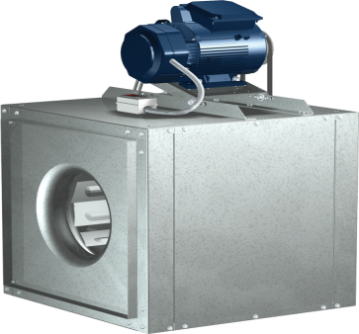
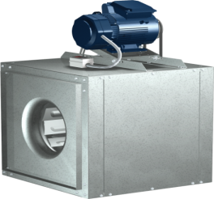
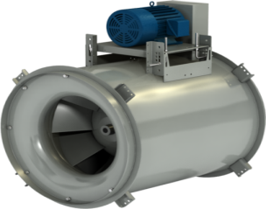
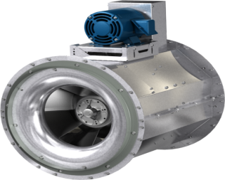
Product Case Study
Design Point: 15,000 CFM at 0.5” Pt
Design
FEI
Oper
Cost
Weight
Housing
Budget
Payback
Fan
Model
BHP
($/year)
(
lbs
)
Width
Cost
(years)
Sq
Inline
30”
5.33
0.62
$1363
571
46”
$3300
-
Sq
Inline
42”
2.92
1.12
$758
735
58”
$4050
1.22
Mixed
Flow
27”
2.77
1.18
$719
611
41”
$6700
5.28
EQB-27
2.83
1.16
$734
451
41”
$3900
0.95
New
Square Inline Fan with Improved Efficiency!!!
New
Lower Cost
Mixed Flow Fan!!!
30” Sq Inline
42” Sq Inline
27” Mixed Flow
EQB-27
Notes:
Operating cost based on $0.10/kW-hr, 5 days per week, 12 hours per day

Slide 40
DOE Fan Energy Index - Applications
How will FEI be used?
Body | FEI Requirement
Federal Regulation | FEI ≥ 1.0 at Design Point
ASHRAE 90.1 | FEI ≥ 1.0 at Design Point
ASHRAE 189.1 | FEI ≥ 1.1 at Design Point
Rebates | FEI = Savings over Baseline
FEI = 1.10 means 10% energy savings over baseline

Slide 41
Benefits of Fan Energy Index(FEI)
FEI will limit fan power based on actual point of operation
  (not the BEST point of operation)
FEI will drive energy savings
FEI can be used with all fans
FEI is a good comparison of relative energy consumption
FEI can be used to incent/rebate “stretch” metrics

Slide 42
Energy Codes

Slide 43
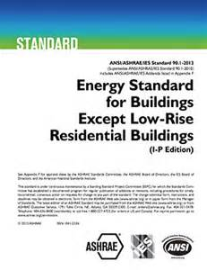

Energy Standard & Code Adoption
“Base Standard”
ASHRAE 90.1-2013
“Base Code”
IECC - 2015

Slide 44
Federal Regulation
Energy Standards/Codes
State Energy Codes must:
  Comply with ASHRAE 90.1- 2013 or equivalent
  and
  Be Submitted to DOE by September 28, 2015
  and
  Be Adopted by September 26, 2016
https://www.energycodes.gov/regulations/determinations

Slide 45
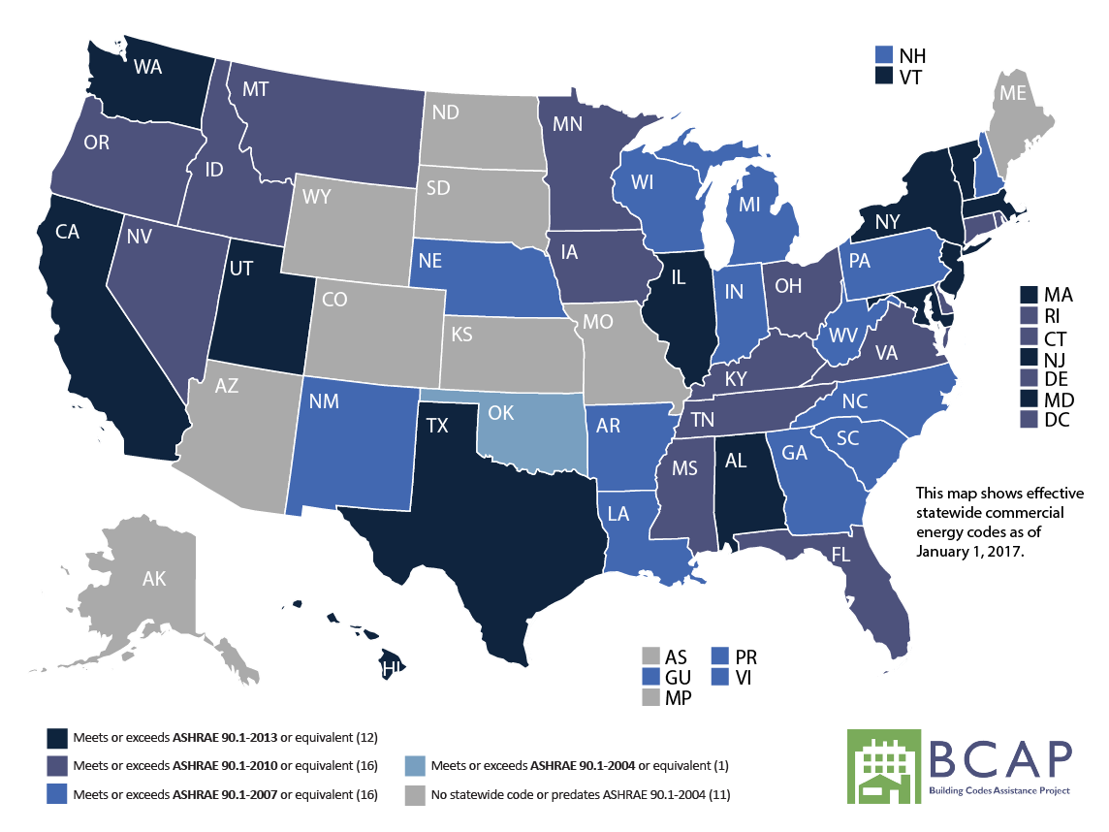
ASHRAE 90.1 Adoption
  https://www.energycodes.gov/status-state-energy-code-adoption ^ http://www.iccsafe.org/wp-content/uploads/stateadoptions.pdf ^ http://bcap-energy.org/code-status/commercial/
Notes:
While state adoption of energy codes is typically lethargic, I sense states are beginning to move quicker to update to the latest version of ASHRAE 90.1 or equivalent for 2 reasons:
The Department of Energy has set a deadline for states to adopt ASHRAE 90.1 or equivalent by September 26 of last year (2016). The reason many states are not complying is that the DOE has no enforcement mechanism.
ASHRAE 90.1-2016 has an alternative method to the typical prescriptive compliance path. This is the Performance Rating Method found in Appendix G. This alternative compliance path offers engineers much more design flexibility to meet code requirements.

Slide 46
Energy Code Fan Requirements

Slide 47
ASHRAE 90.1-2013
6.5.3.1 Fan System Power and Efficiency Limitation
6.5.3.1.3 Fan Efficiency. Fans shall have a Fan Efficiency Grade (FEG) of
67 or higher based on manufacturers’ certified data, as defined by AMCA 205. The total efficiency of the fan at the design point of operation shall be within 15 percentage points of the maximum total efficiency of the fan.
Exceptions:
Single fans with a motor of 5 hp (4 kW) or less.
Multiple fans in parallel or series that have a combined motor power of 5 hp (4 kW) or less and are operated as the functional equivalent of a single fan.
Fans that are part of equipment listed under 6.4.1.1 Minimum Equipment Efficiencies – Listed Equipment – Standard Rating and Operating Conditions.
Fans included in equipment bearing a third-party-certified seal for air or energy performance of the equipment package.
Powered wall/roof ventilators (PRV) as defined by ANSI/AMCA-99-2010.
Fans outside the scope of AMCA 205
Fans that are intend to only operate during emergency conditions
Notes:
This is the latest proposal being considered by the ASHRAE 90.1. This is out for public review and comment.

Slide 48
ASHRAE 90.1-2013 Fan Curve
6.0
Ps vs. CFM
5.0
100
4.0
80
15 points of
peak efficiency
Ps
3.0
Total Efficiency vs. CFM
60
Efficiency
Compliant
2.0
40
Non-Compliant
1.0
20
0.0
0
0
2
4
6
8
10
12
CFM x 1000
Notes:
Selection within 15 points of peak efficiency allows a range down to 60%

Slide 49
ASHRAE 90.1-2013
6.5.3.1 Fan System Power and Efficiency
Constant Volume | Variable Volume
HP<= CFM*0.0011 | HP<= CFM*0.0015
eCAPs Demo

Slide 50
ASHRAE 90.1-2013
6.5.3.5 Fractional Horsepower Fan Motors. Motors for fans that are 1/12 hp or greater and less than 1 hp shall be electronically-commutated motors or shall have a minimum motor efficiency of 70% when rated in accordance with DOE 10 CFR 431. These motors shall also have the means to adjust motor speed for either balancing or remote control. Belt-drive fans may use sheave adjustments for airflow balancing in lieu of varying motor speed.
Exceptions:
Motors in the airstream within fan-coils and terminal units that operate only when providing heating to the space served.
Motors installed in space conditioning equipment certified under Section 6.4.1
Motors covered by Table 10.8-4 or

Slide 51
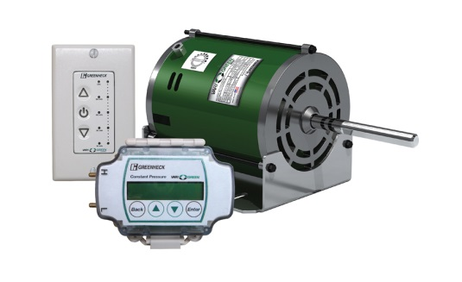
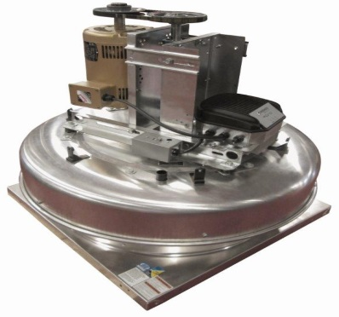
Fractional Horsepower Motors
Single phase applications will require EC motors to meet efficiency requirements
Three phase applications may require VFDs to balance or for remote control
Take advantage of low cost speed control with VFD Integrated with Motor & Control

Slide 52
Elements of Fan System Energy
(Personal Perspectives)

Slide 53
Elements of Fan “System” Power*
Fan Design
Fan Control/Sensors
Fan Selection
System Effect &
System Leakage
Air Distribution
System Design & Components
*Mike Wolf – Unscientific Estimates

Slide 54
Fan Selection of 15,000 CFM at 4” Ps
Fan Selection to Minimize Energy
Select Fans Based on Total Cost of Ownership
SW Airfoil Centrifugal
Fan Class
Oper BHP
COST
5 year
TCO
22
III
24.5
$4,995
$26,927
24
III
19.0
$5,113
$22,122
27
II
16.2
$3,933
$18,435
30
II
13.6
$4,170
$16,345
Size 33 has the lowest TCO
33
I
12.5
$4,327
$15,517
36
I
12.0
$4,995
$15,737
Notes:
This is a slide to point out that FEGs are NOT a tool for fan selection.
This chart shows information on a group of fans, single wide airfoil centrifugals, that might be considered for an application using an electronic fan selection program. All 6 of the fan sizes shown can be used to meet the requirement of 15,000 CFM at 4” Ps. The available sizes are shown from smallest to largest. The small fans are higher speed and you can see they are bumped into higher classes. The absorbed power varies considerably – the smallest fan using twice the power as the larger fan.
Actual fan static efficiency is shown, varying from 38% to 78%.
Actual total efficiency, as expected, is higher, ranging from 55% to 83%.
We can look at the peak static efficiency attainable for each size.
And finally the peak total efficiency attainable for each size.
Now notice the FEG values for each size – They are all the same! So again, FEGs are NOT a tool for making a fan selection. They simply classify the fan based on its peak TE, or its potential to be used as an efficient fan.

Slide 55
Fan Selection to Minimize Energy
18
Include Max Fan RPM on Equipment Schedule to Avoid Undersized Low Efficiency Fan Selections.
Include Max Bhp on Equipment Schedule to assure compliance with Fan System Power limit in Energy Code
20
22
24
Ps
27
30
Design Duty
CFM
Notes:
Now lets look at what this means when you go to select a fan size.
For a given airflow and static pressure, you can either select a smaller fan running at a higher speed, or you can select a larger fan running at a slower speed.
This slide shows that you might have 6 different size fans that go through the same CFM and pressure. The choice is often a trade-off between fan efficiency and stability:
The smaller fans that run fast and loud and are not very efficient;
The larger fans that run slower are both quieter and more efficient.
But the larger the fan, the closer you get to the surge line. And this can be a problem for stability, especially with VAV systems or parallel fans.
In this example, a size 24 would probably give a high efficiency while still leaving enough room for increased pressure in the system.

Slide 56
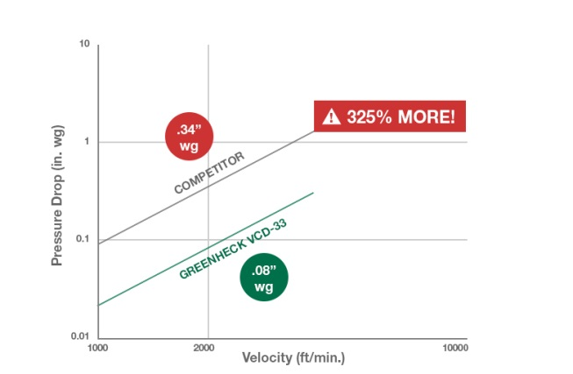
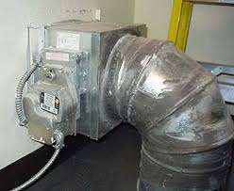
Air Distribution System Design & Components to Minimize Energy
Design Pressure Loss – Varies Based on Components
  e.g. ducts/dampers
eCAPs Demo

Slide 57
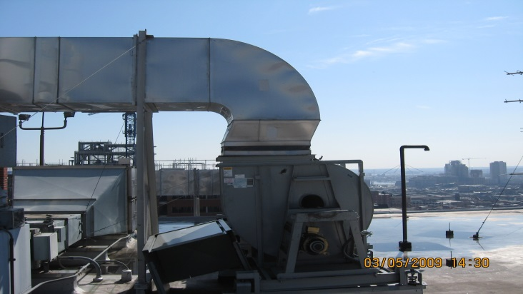
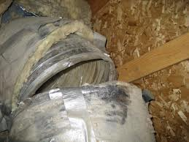
System Effect & System Leakage
to Minimize Energy
Minimize System Effect
eCAPs Engineering Toolbox

Slide 58

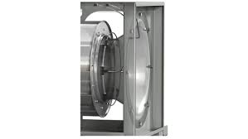
Fan Controls & Sensors to Minimize Energy
Avoid Overventilation w/ Variable Speed Controls
Non-Invasive Airflow Monitoring
Integrated Sensors & Speed Controls

Slide 59
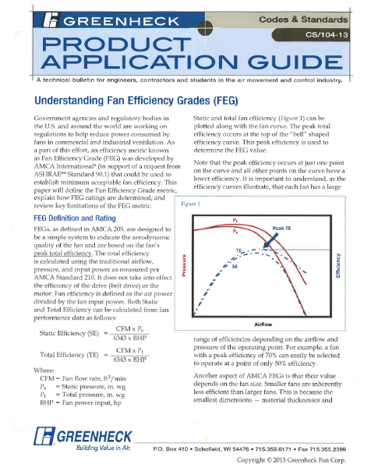
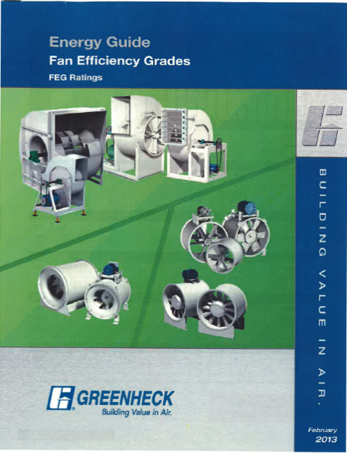
Homework
Review what you have learned here.
Share this info (FACTS) with your fellow consulting engineers, Architects, contractors, and end users, and code officials.
Greenheck Product Application Guide, Understanding Fan Efficiency Grades
  http://www.greenheck.com/library/articles/88
Greenheck also has an FEG Energy Guide.
Read more: http://www.csemag.com
  Search “FEG”

Slide 60

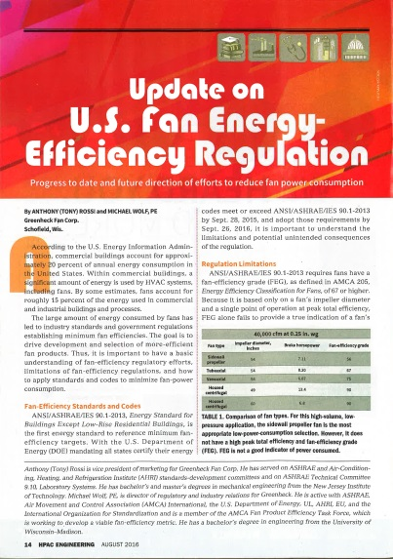
Reference Material
Introducing the Fan Energy Index; Air Movement and Control Association
  https://www.amca.org
HPAC Engineering Greenheck Product Update on U.S. Fan Energy-Efficiency Regulation
  http://hpac.com/iaq-ventilation/update-us-fan-energy-efficiency-regulation

Slide 61

The mission of Greenheck is to be the market leader in the development, manufacture and worldwide sale of quality air moving, control and conditioning equipment with total commitment to customer service.

